Slide 1

Computer Security
Group Project
Ethical hacking tools usage on Kali Linux
Instructor: Professor Noh
Group Of Students:
Truong Dang Truc Lam - B2111933
Ho Kim Trong - B2111963
Nguyen Duy Bang - B2111971

Slide 2
Group Project: Ethical hacking tools usage on Kali Linux
Table Of Contents
The concept of Ethical Hacking
Examples of Hacking tools
Practice using Hacking tools
Conclusion

Slide 3
Group Project: Ethical hacking tools usage on Kali Linux
The concept of Ethical Hacking

Slide 4

Group Project: Ethical hacking tools usage on Kali Linux
Ethical Hacking
Using hacker techniques for good
Proactive security testing
Identifying and fixing vulnerabilities
Protecting systems from malicious attacks
Strengthening security defenses

Slide 5

Group Project: Ethical hacking tools usage on Kali Linux
Kali Linux
A Debian-based Linux distribution
Designed for ethical hacking
Pre-installed security tools
User-friendly environment for all levels
Leading choice for security research

Slide 6

Group Project: Ethical hacking tools usage on Kali Linux
Kali Linux
A Debian-based Linux distribution
Designed for ethical hacking
Pre-installed security tools
User-friendly environment for all levels
Leading choice for security research

Slide 7
Group Project: Ethical hacking tools usage on Kali Linux
Examples of Hacking tools

Slide 8

Group Project: Ethical hacking tools usage on Kali Linux
Burp Suite
Web application security testing tool
Penetration testing and vulnerability assessment
Intercept, inspect & modify HTTP/HTTPS traffic
Automated scanning for vulnerabilities
Extendable with third-party plugins

Slide 9

Group Project: Ethical hacking tools usage on Kali Linux
Wireshark
FOSS network protocol analyzer
Captures and analyzes network packets
Used for analysis & troubleshooting
Decodes various network protocols
Provides detailed packet information

Slide 10

Group Project: Ethical hacking tools usage on Kali Linux
John the Ripper
FOSS password cracking tool
Supports various hash types and platforms
Offers multiple cracking modes
Used for security testing and password recovery
Perform dictionary, brute-force, and hybrid attacks

Slide 11
Group Project: Ethical hacking tools usage on Kali Linux
Practice using Hacking tools

Slide 12
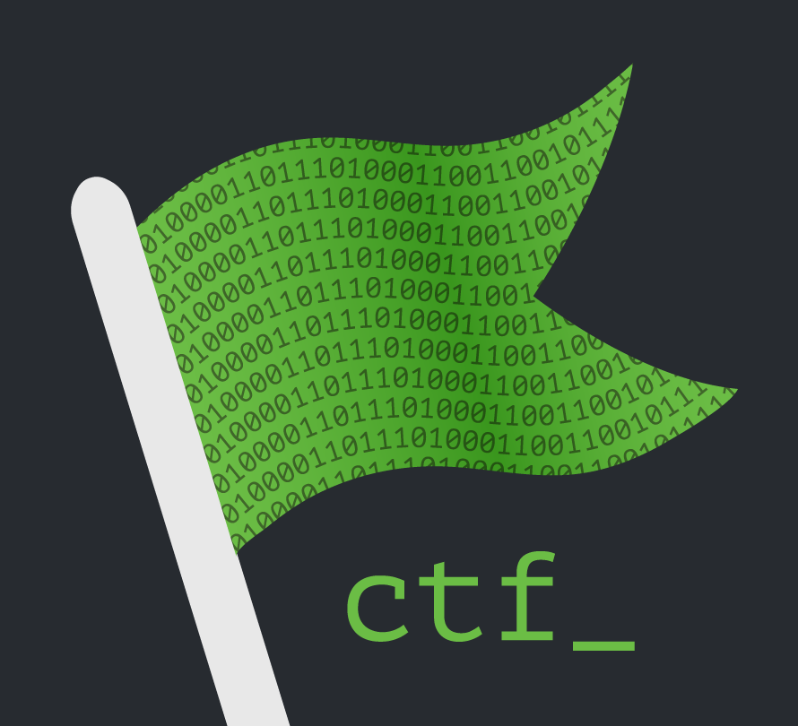
Group Project: Ethical hacking tools usage on Kali Linux
Capture The Flag
Learn and practice cybersecurity skills
Solve security challenges to find “Flags“
Many topics: Cryptography, Forensics, Web, Reverse Engineering, etc.
Friendly competition with others

Slide 13

Group Project: Ethical hacking tools usage on Kali Linux
Using tools to solve Challenges

Slide 14
Group Project: Ethical hacking tools usage on Kali Linux
Conclusion

Slide 15
Group Project: Ethical hacking tools usage on Kali Linux
Benefits of learning Ethical Hacking
Enhanced Security Awareness: Understanding Hacking techniques allows you to identify and mitigate potential security risks, protecting your systems and data
Problem-Solving Skills: Ethical Hacking challenges you to think critically and creatively to find solutions to complex security problems
Career Opportunities: Certified Ethical Hackers are in high demand, opening doors to lucrative and fulfilling Cybersecurity careers
Continuous Learning: The Cybersecurity landscape is constantly evolving, so Ethical Hacking keeps you updated on the latest threats and defense strategies.
Intellectual Stimulation: Ethical Hacking is a mentally stimulating field that requires constant learning and adaptation, keeping your mind sharp and engaged

Slide 16
Thank you for watching

